Slide 1

Real Estate Agency
Course:
CSC-100L Applications of Information and Communication Technologies H
Instructor:
Mam Ramsha Khalid
Session:
FALL 2025
Group Members:
Moghees Mohiuddin Roll No. 2025-CS-210
M. Arslan Emran Roll No. 2025-CS-200
M. Shahzaib Roll No. 2025-CS-204
MA. Choudhary Roll No. 2025-CS-184
Muhammad Anas Roll No. 2025-CS-229

Slide 2
INTRODUCTION
A real estate agency helps clients buy, sell, and manage properties such as land, apartments, villas, and commercial buildings.
This project develops a user-friendly real estate website that acts as a secure and organized platform for buyers, sellers, and agents.
Key sections include Home, Buy, Sell, Agents, About Us, and Feedback to simplify property search, listing, and communication.
The website improves transparency, trust, and efficiency while demonstrating how modern real estate businesses operate digitally.

Slide 3
OBJECTIVES
To design a clear home page presenting the company and its services.
To provide Buy and Sell sections for easy property searching and listing.
To display detailed property information and professional agent profiles.
To help users choose suitable agents based on their needs.
To build trust through an About Us page and improve services using user feedback.

Slide 4
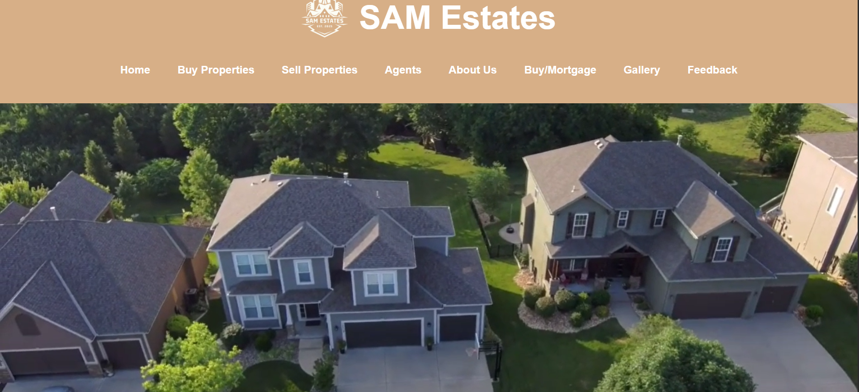
WEBSITE OVERVIEW
Our website consists of eight main pages designed for easy navigation.
Home
Buy
Sell
Agents
About us
Feedback
Mortgage
Gallery

Slide 5
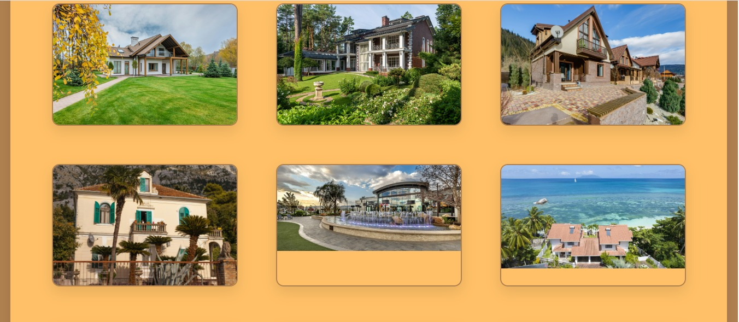
WEBSITE OVERVIEW
HOME

Slide 6
DESIGN
Clean UI for easy navigation
Separate pages for buyers and sellers
Simple color scheme
Organized data display

Slide 7
Inventory, Status, Deal
We used Excel to analyze business performance including status, deal, inventory.

Slide 8
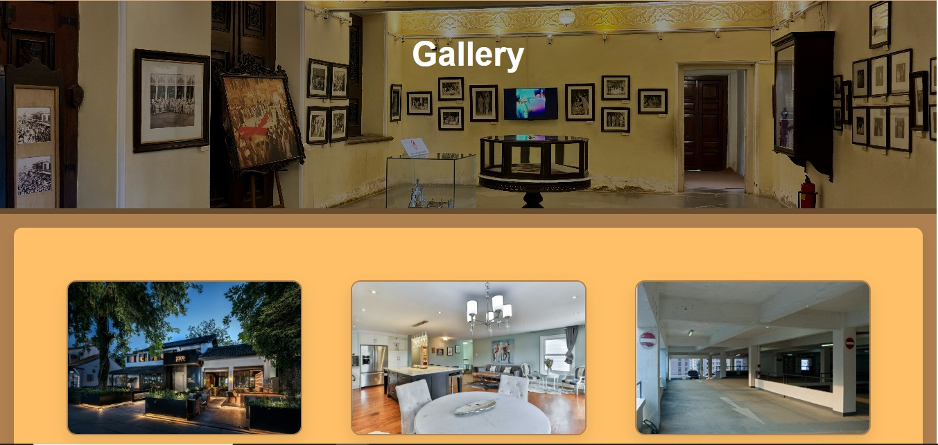
PROPERTY TOUR
The gallery works as a virtual tour for users

Slide 9
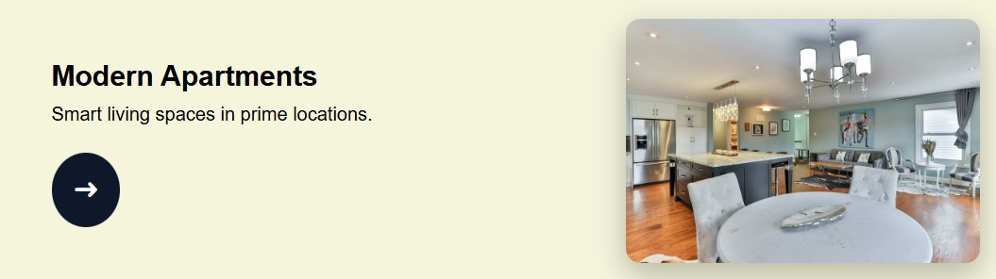
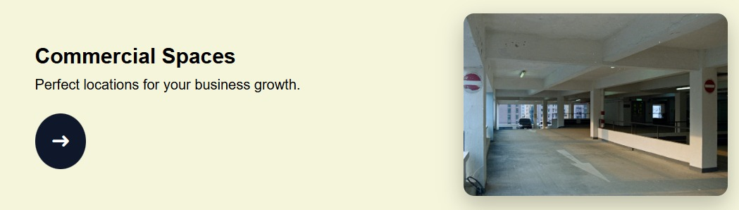

Our Services

Slide 10

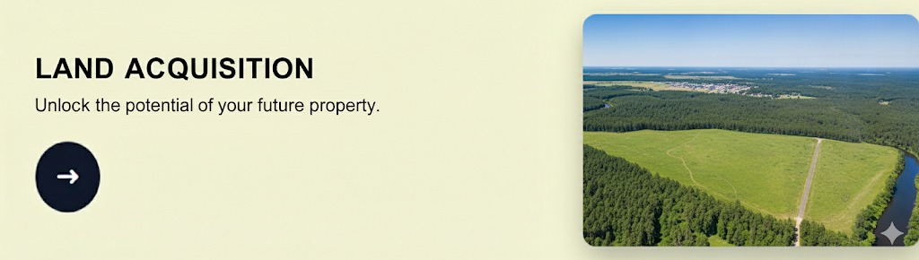
Our Services

Slide 11
GITHUB DEMO
GitHub Link: https://bit.ly/3Lbphbh
Live Website Link: https://bit.ly/45hm94z

